Slide 1



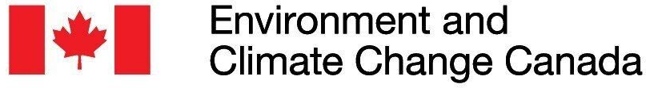


Optimizing ecological surveys for conservation
Jeffrey O. Hanson, Jenny L. McCune, Iadine Chadès,
Caitlyn A. Proctor, Emma J. Hudgins, Joseph R. Bennett
jeffrey.hanson@uqconnect.edu.au
jeffrey-hanson.com

Slide 2
Now
Biodiversity
Status quo
2000
Future

Slide 3
Now
How do we
get here?
Biodiversity
Status quo
2000
Future

Slide 4



Ecological surveys
Distribution maps
Priority areas
Biodiversity
2000
Future
Data
Information
Plan
Outcome
Objectives
Constraints

Slide 5
Ecological surveys
Distribution maps
Priority areas
Biodiversity
?
?
?
?
?
?
2000
Future
Data
Information
Plan
Outcome
More
surveys
Better
models
Better
management
Better
outcome
Objectives
Constraints

Slide 6
Ecological surveys
Distribution maps
Priority areas
Biodiversity
?
?
?
?
?
?
?
?
?
?
?
?
2000
Future
Data
Information
Plan
Outcome
More
surveys
Better
models
Poorer
management
Worse
outcome
Objectives
Constraints
Less funding

Slide 7
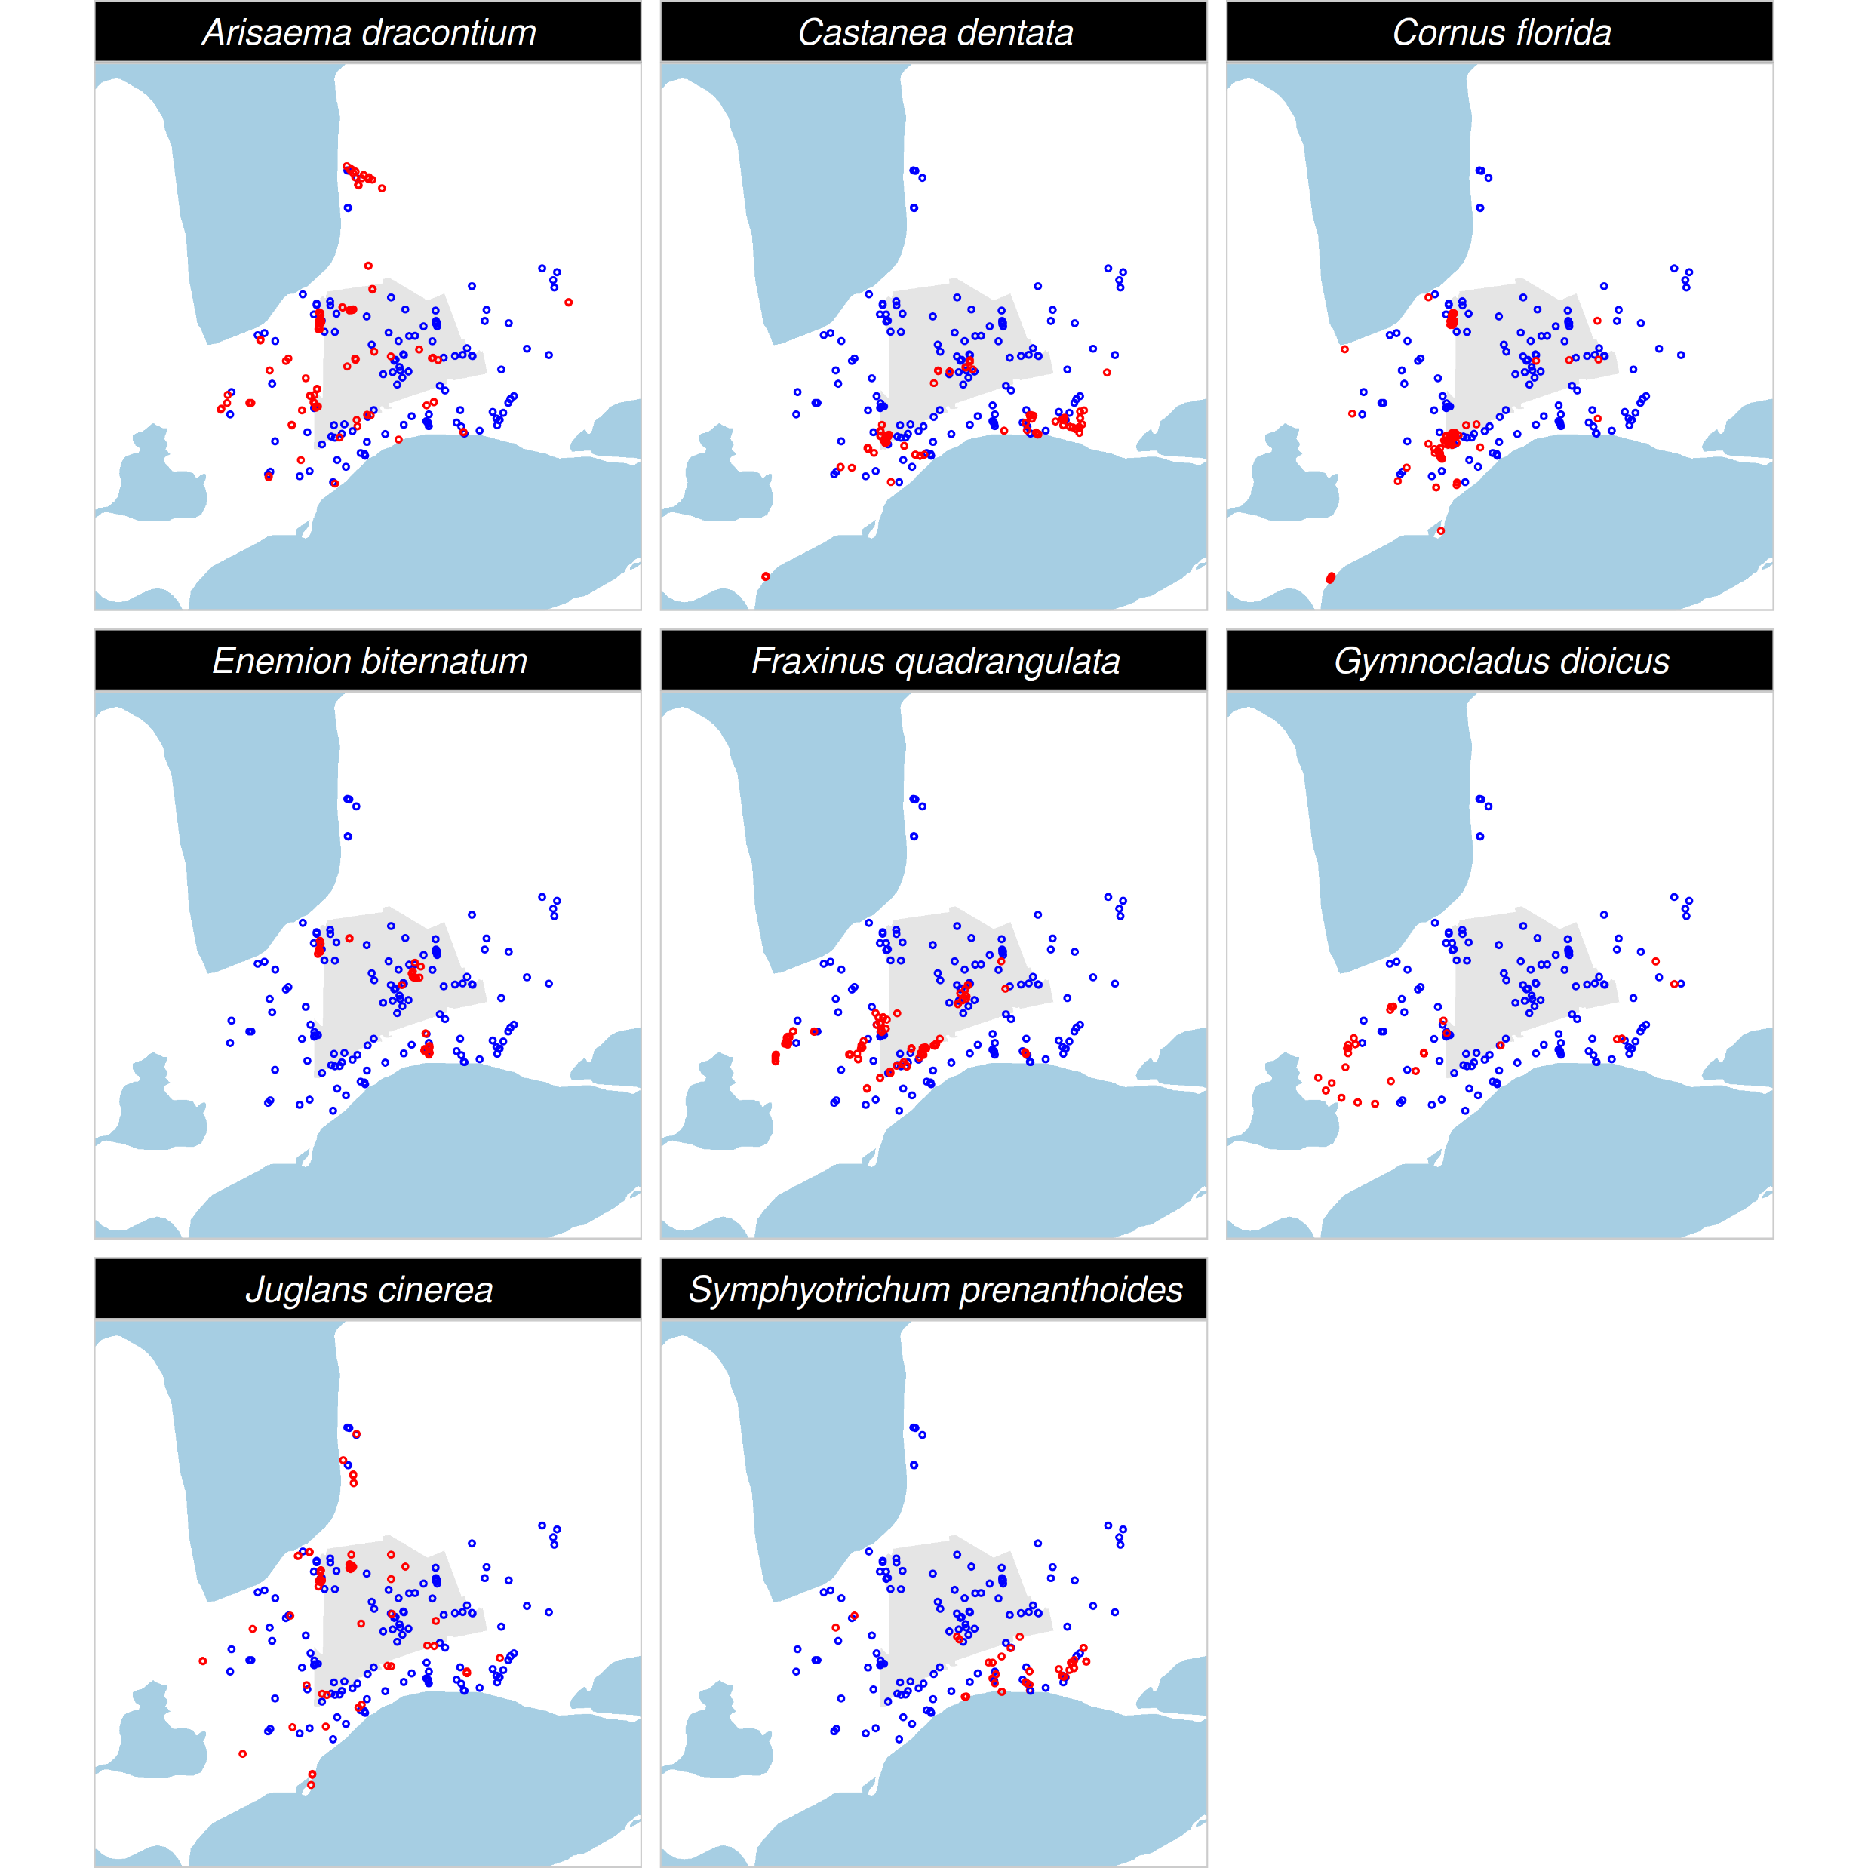
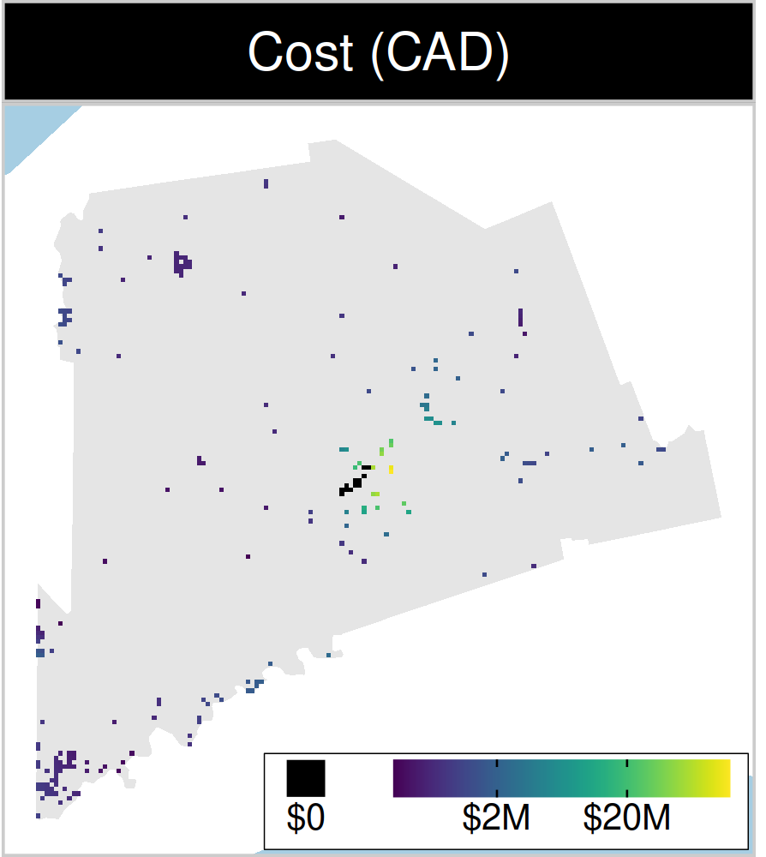
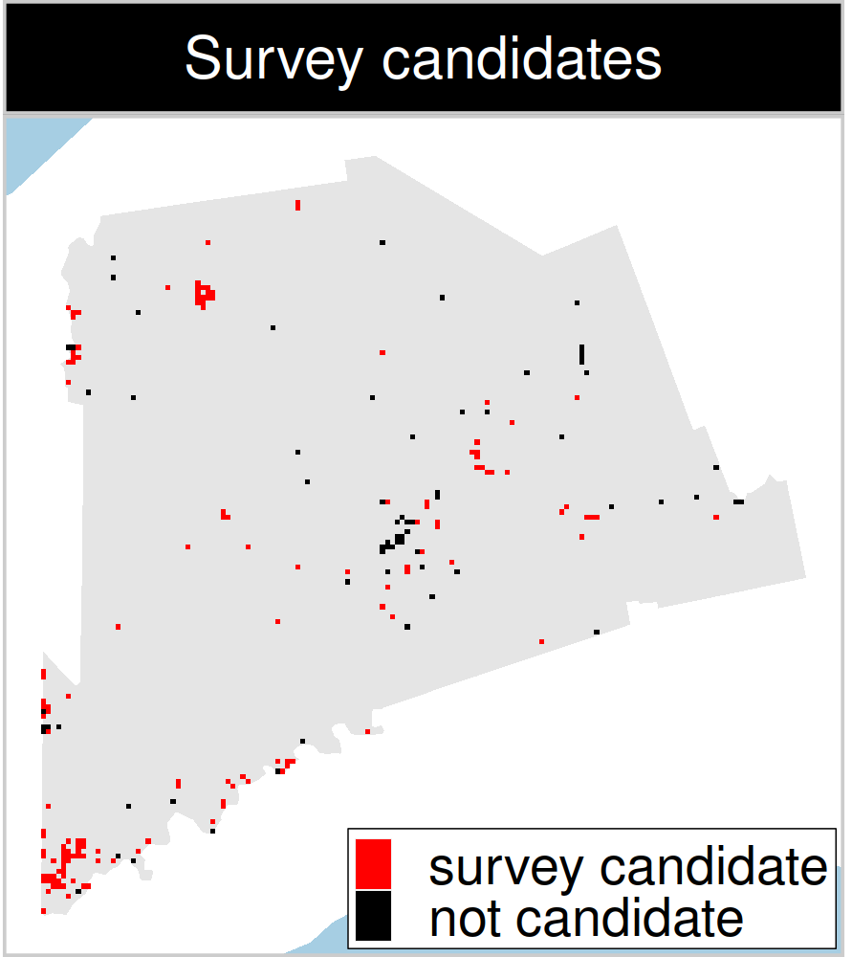
Study system: Middlesex country, Canada
199 places that could
potentially be acquired for
protected area establishment
143 places that could potentially be surveyed to
improve existing data
8 imperilled plant species
Notes:
7

Slide 8
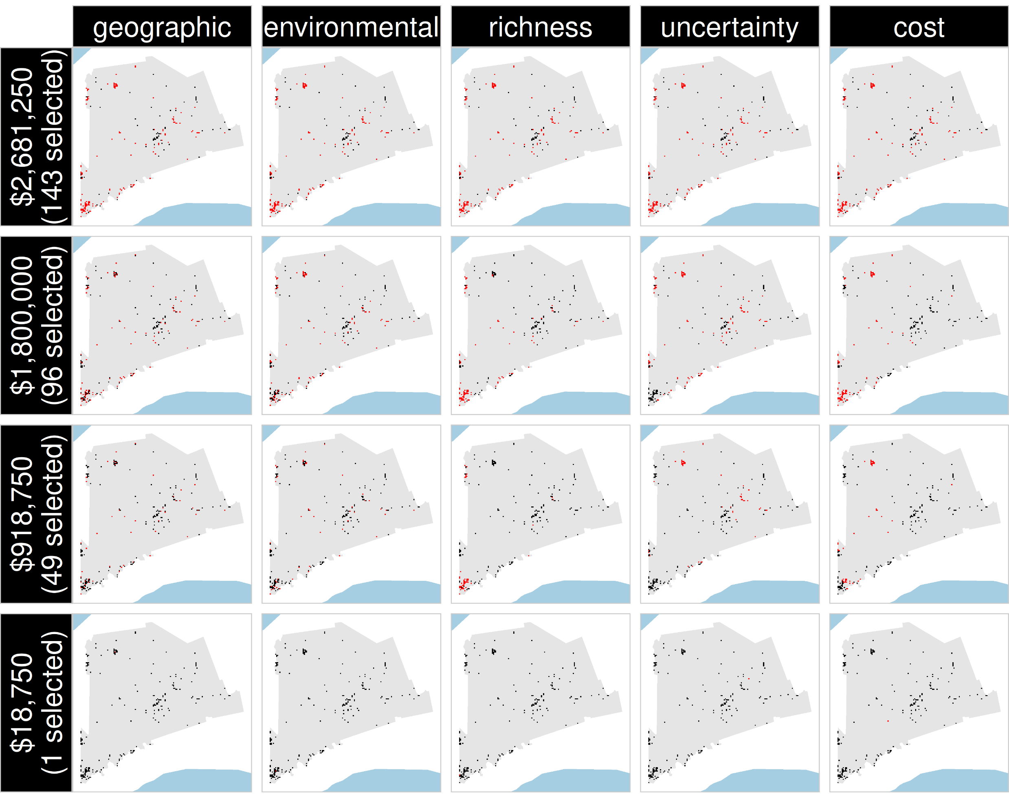
Selected
for survey
Number of places selected for surveys
(amount of funds allocated for collecting extra data)
NOT selected
for survey
Different approaches for designing survey schemes

Slide 9
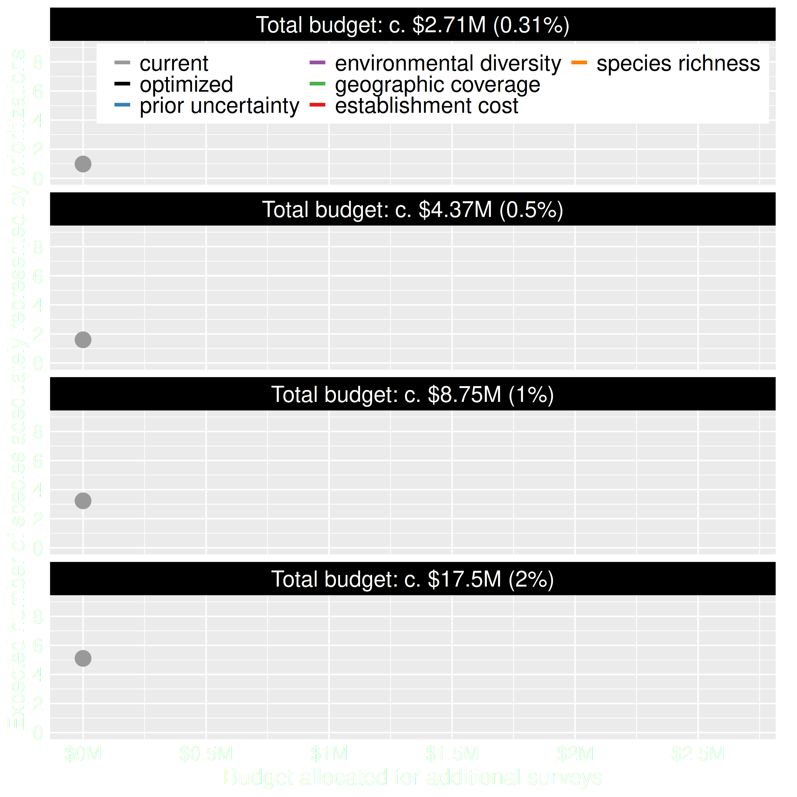
Value of information
Existing data leads to positive outcomes
More budget means better outcomes

Slide 10
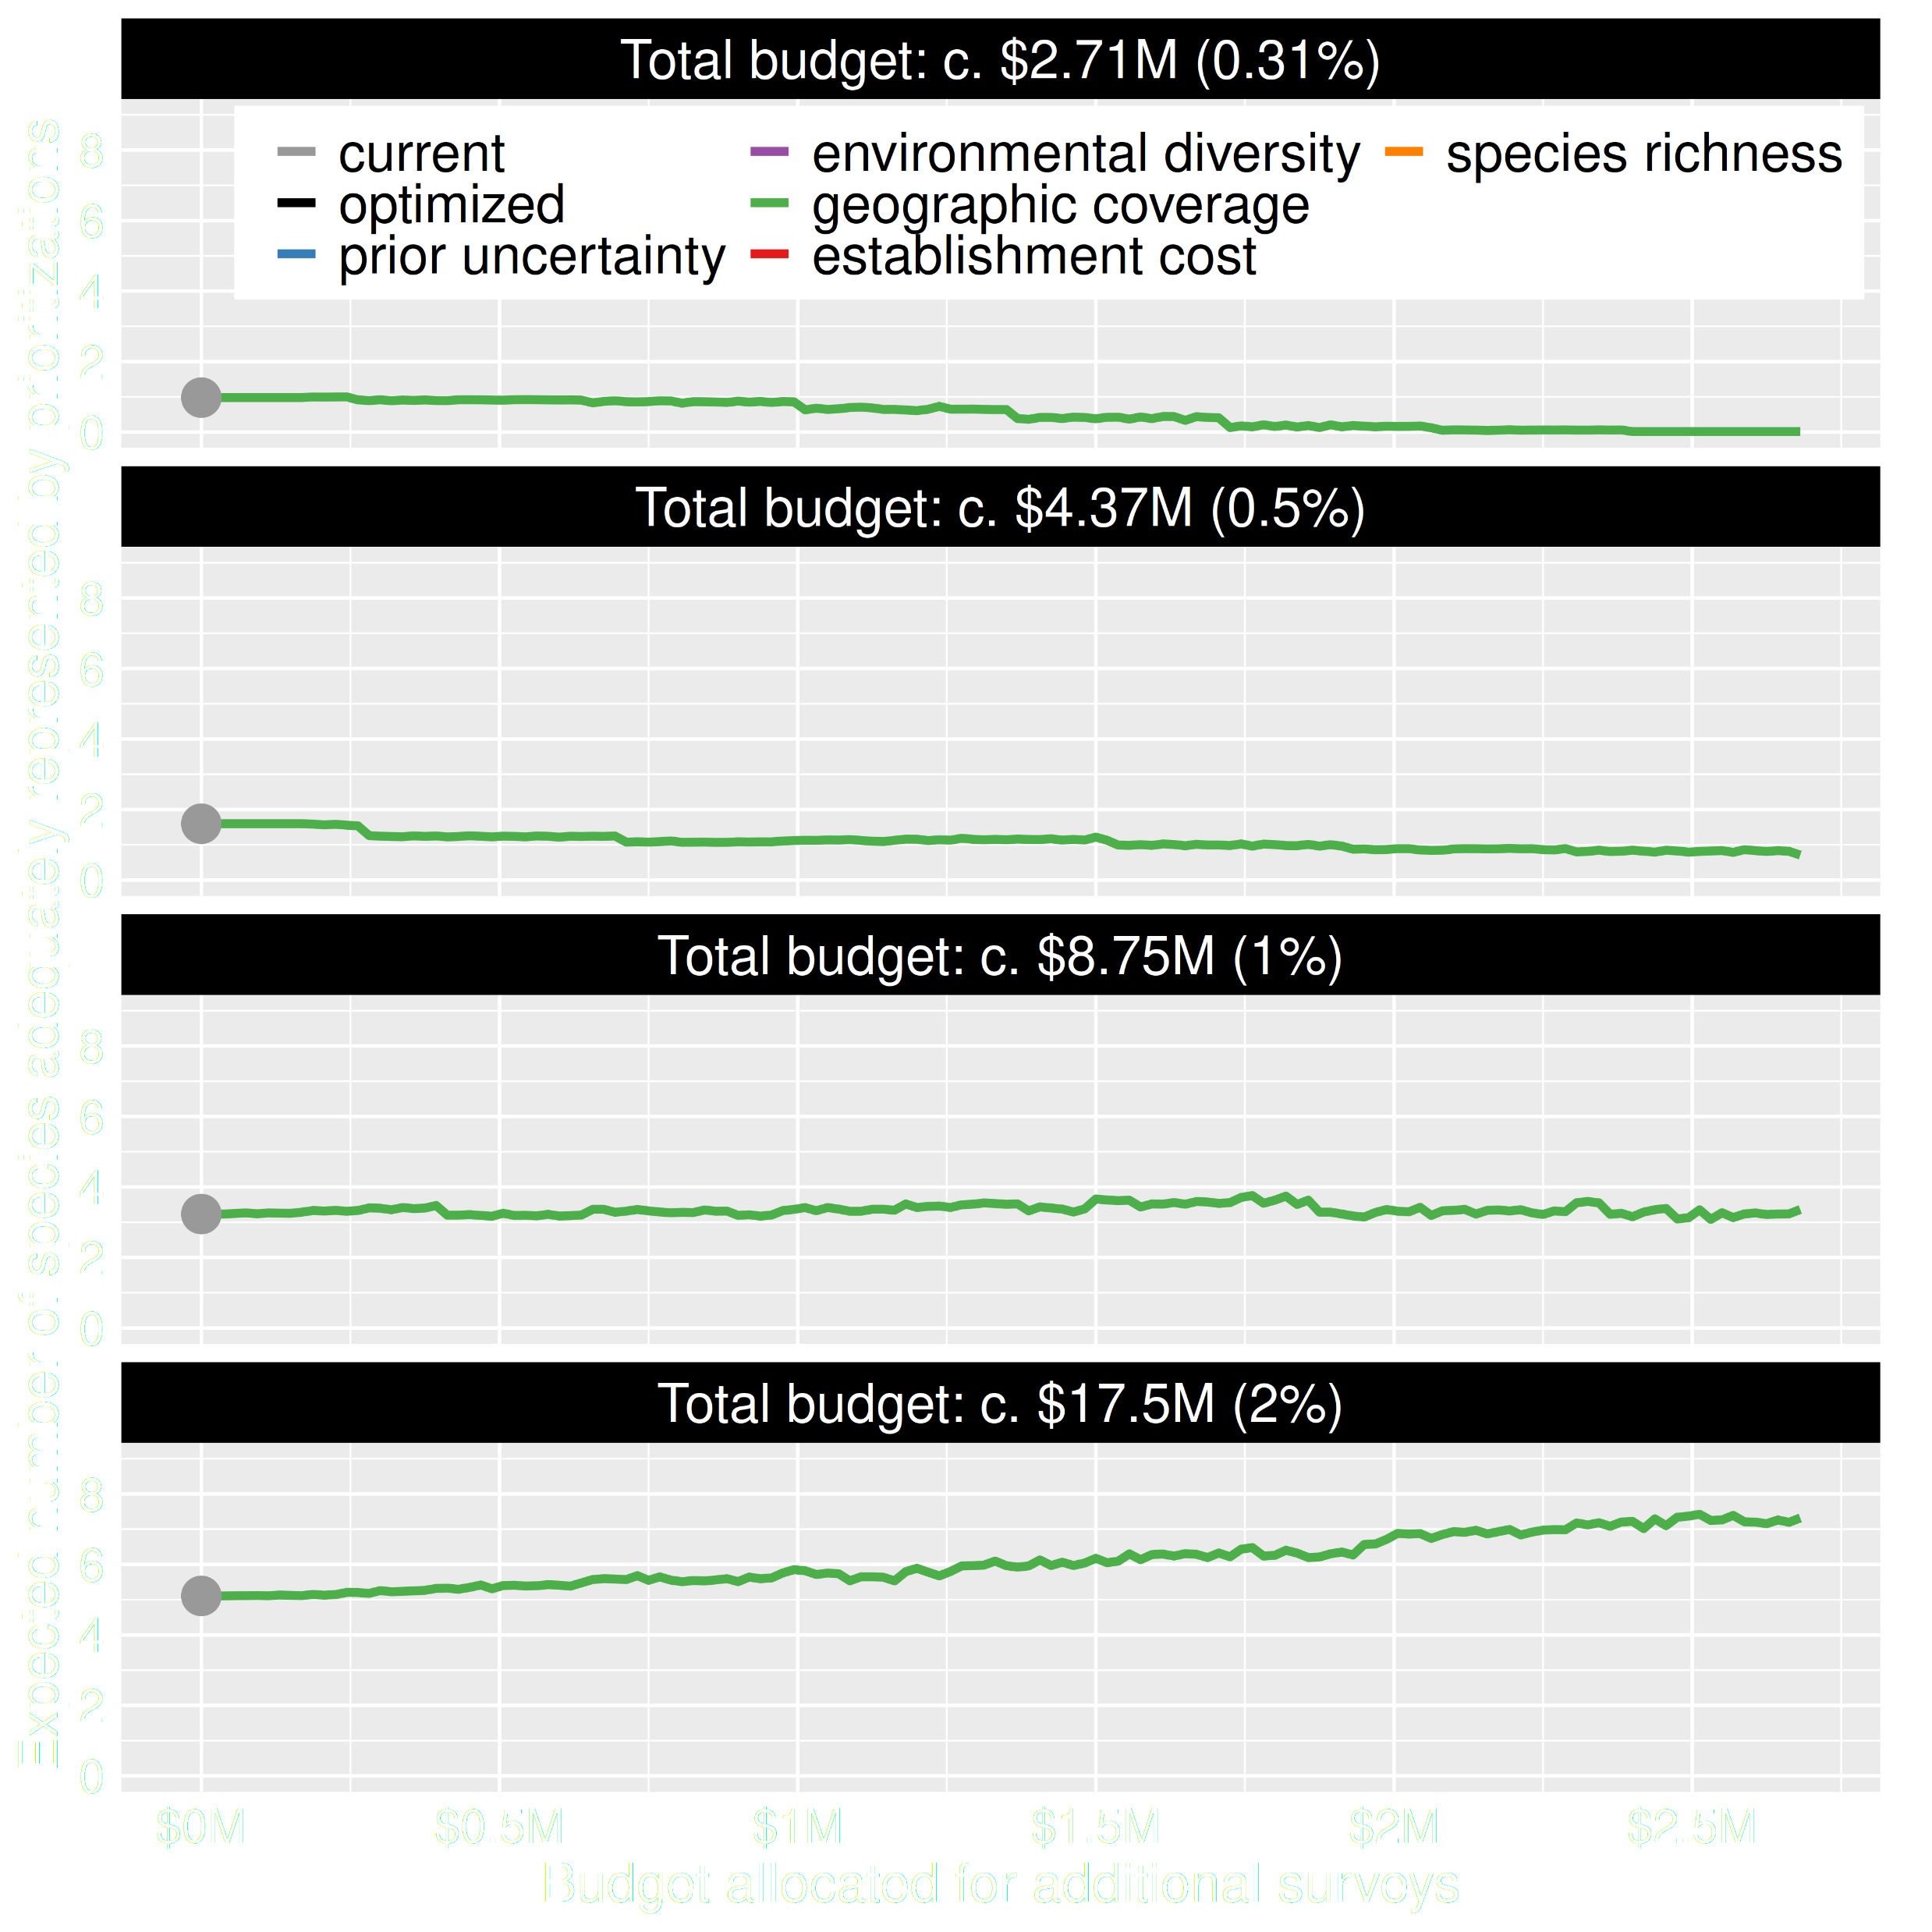
Value of information
Allocating funds for gathering more data can mean worse outcomes
Allocating funds for gathering more data can mean better outcomes too

Slide 11
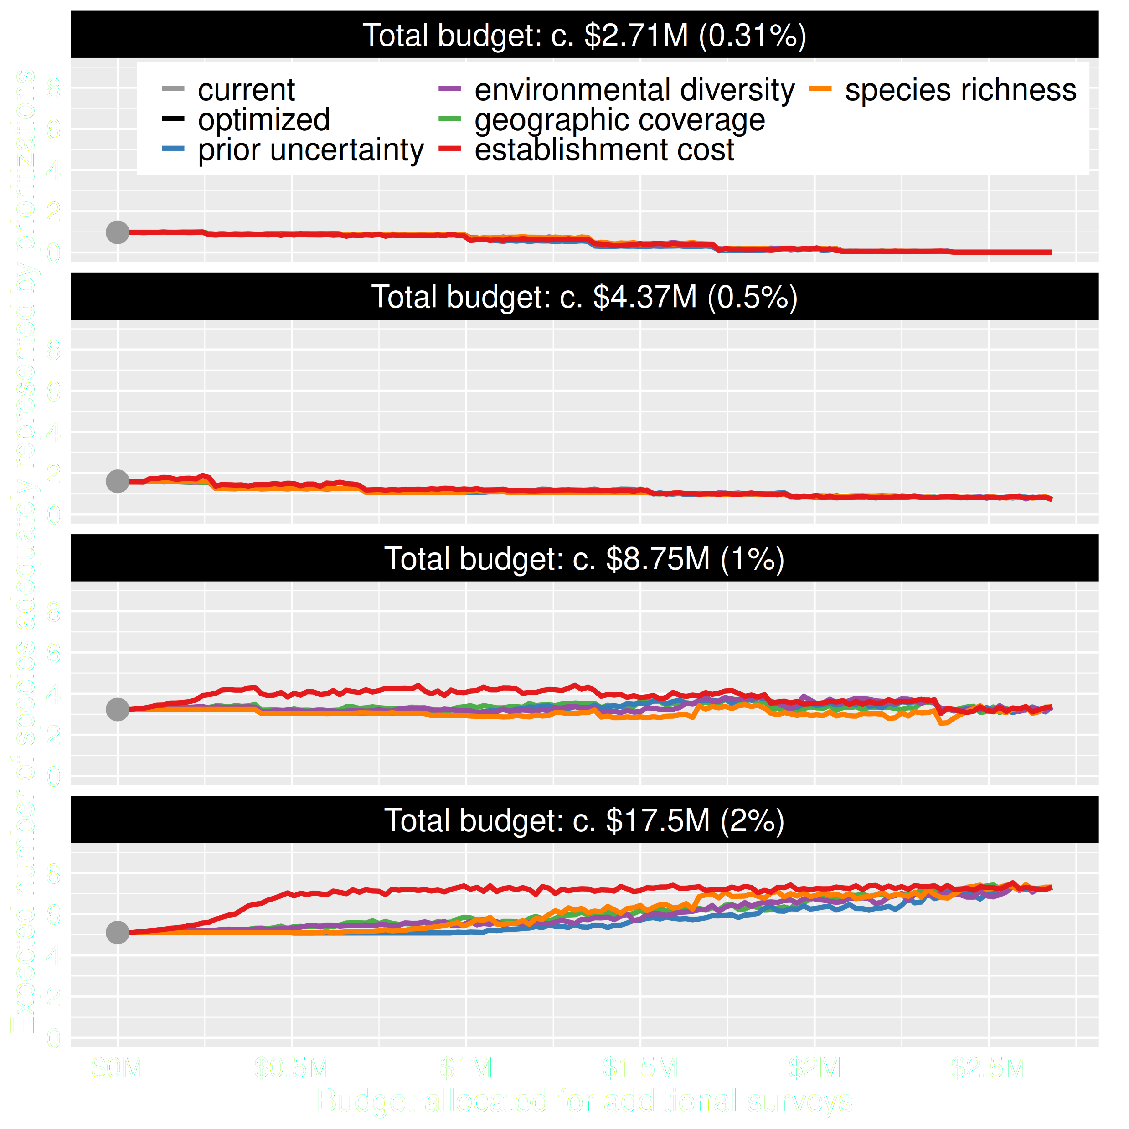
Value of information
Conventional approaches for gathering additional evidence have different performance
Performance of these approaches depends on available funds
All of them could lead to lead to worse outcomes

Slide 12
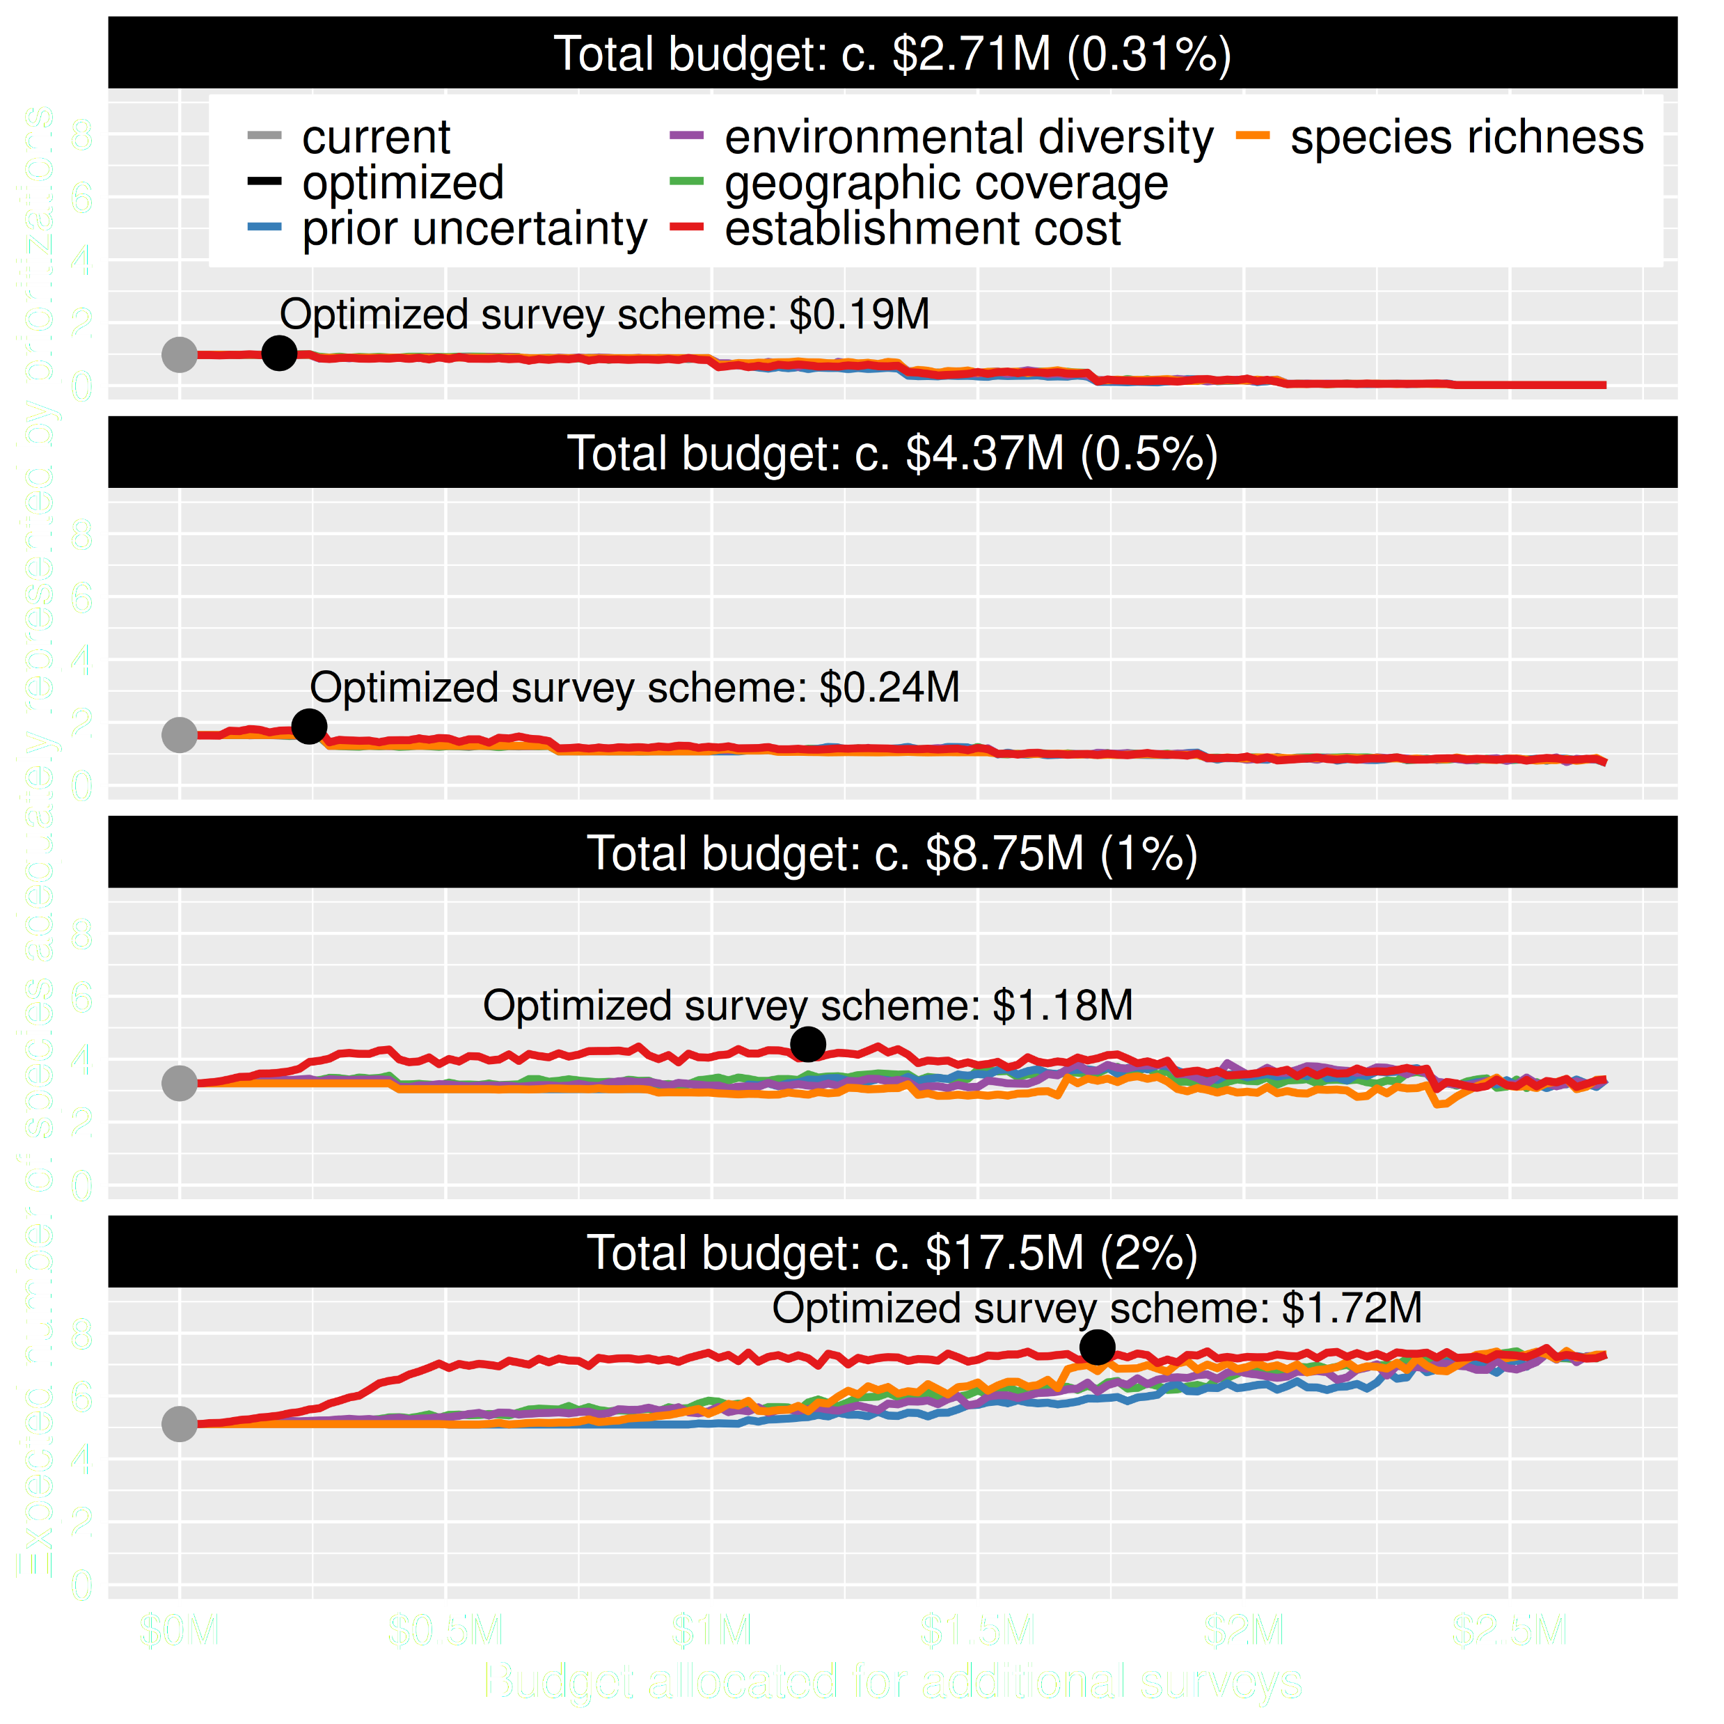
Value of information
Directly maximizing return on investment is best method for additional data
This considers objectives and constraints that underpin conservation plans and their success

Slide 13
Take home messages
Don’t spend most funding on data collection
Survey designs that might be effective for ecological studies can be inefficient for conservation decision making
Value of information analyses can design surveys that maximize conservation objectives
R package at https://prioritizr.github.io/surveyvoi

Slide 14
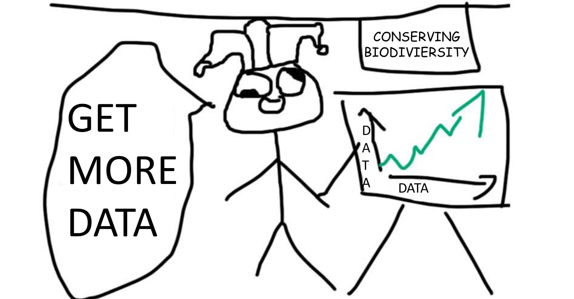
More data is not always better

Slide 15




jeffrey.hanson@uqconnect.edu.au
github.com/jeffreyhanson
jeffrey-hanson.com

